Slide 1
Data Science Project
Sentimental Analysis of Reviews
Gregor Pawlak s0563317
Karsten Saß s0568771

Slide 2
Our Agenda for today:
Goals of our project
Data sources and applied technologies
Problems encountered in the project
Presenting a python script
Presenting the results in Tableau

Slide 3
What we want to discover for you:
How customers' feelings change over time?
What customers think about any places in the city?

Slide 4
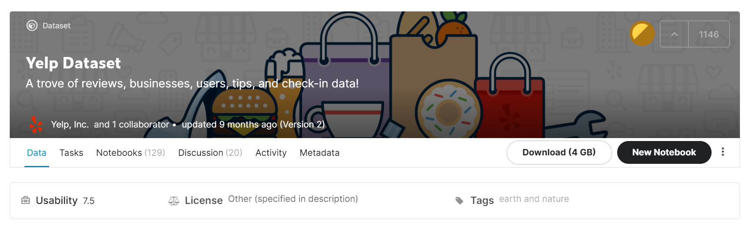
Data Source
Yelp Database on Kaggle.com: https://www.kaggle.com/yelp-dataset/yelp-dataset

Slide 5
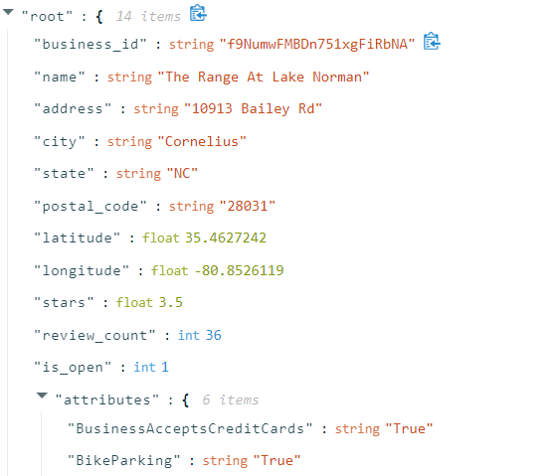
Yelp Database
Two tables:
Business: name, address, location, average rating
Reviews: text of the review, rating
Inner join on the field Business ID.

Slide 6
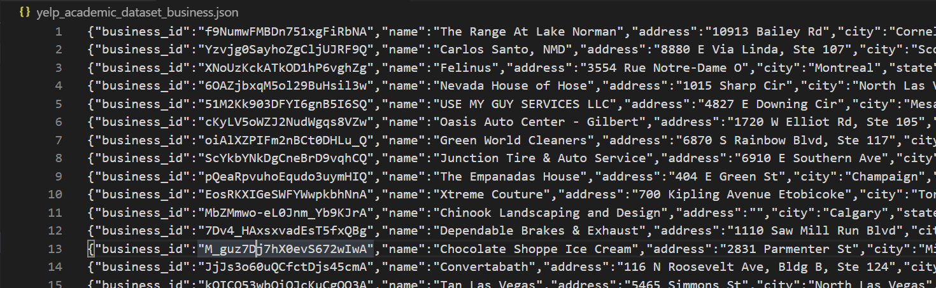
Structure of the JSON file forces us to read the file line by line. About 5 GB data volume.

Slide 7






Applied Technologies
Automatic download of data sets with Kaggle API
Viual Studio Code + Jupyter Notebook environment
Scikit learn for data modelling
Excel to save and export data
Tabelau for presentation

Slide 8
Project Problems:
Problems:
JSON file not easy readable - it is necessary to write a function that reads the data line by line
Big load of data slows down processing in Jupyter Notebook and Tableau
Two methods of exporting data to Tabelau - Document Term Matrix and Split to single words

Slide 9
Python Script

Slide 10
Thank you for your attention

